Slide 1


www.lifeguardkenya.org

Slide 2



Slide 3


RECOGNIZE
1
RESPOND
2
REPORT
3
OKOA MTOTO
Child abuse include physical, Sexual and emotional abuse, neglect and risk of harm

Slide 4




Slide 5

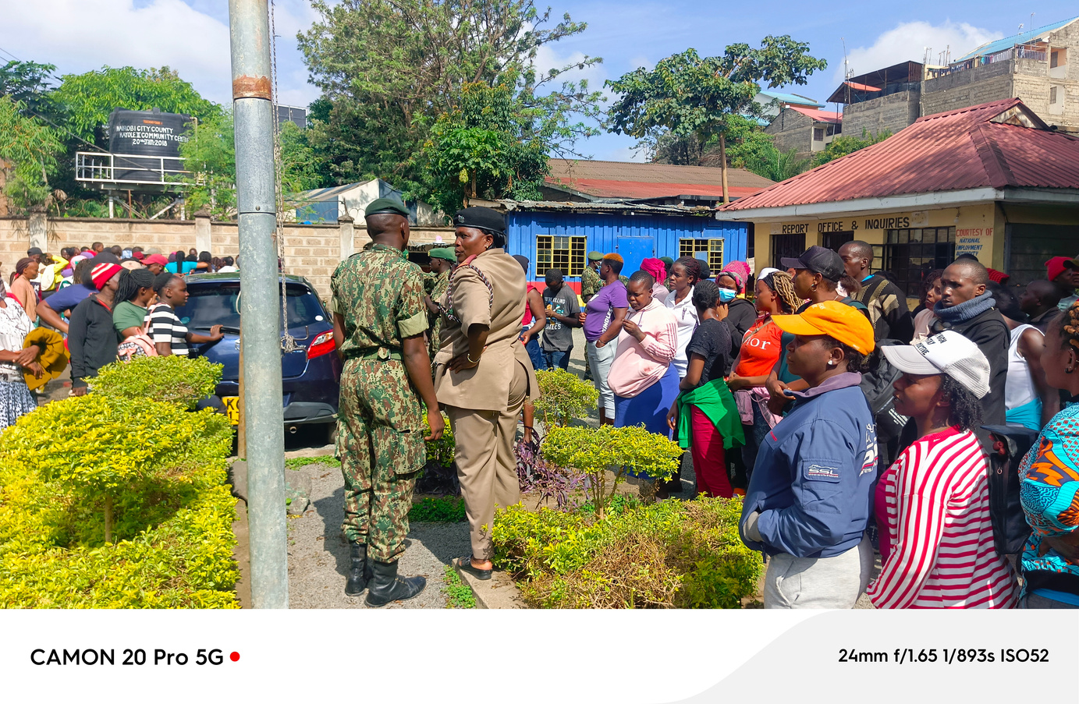
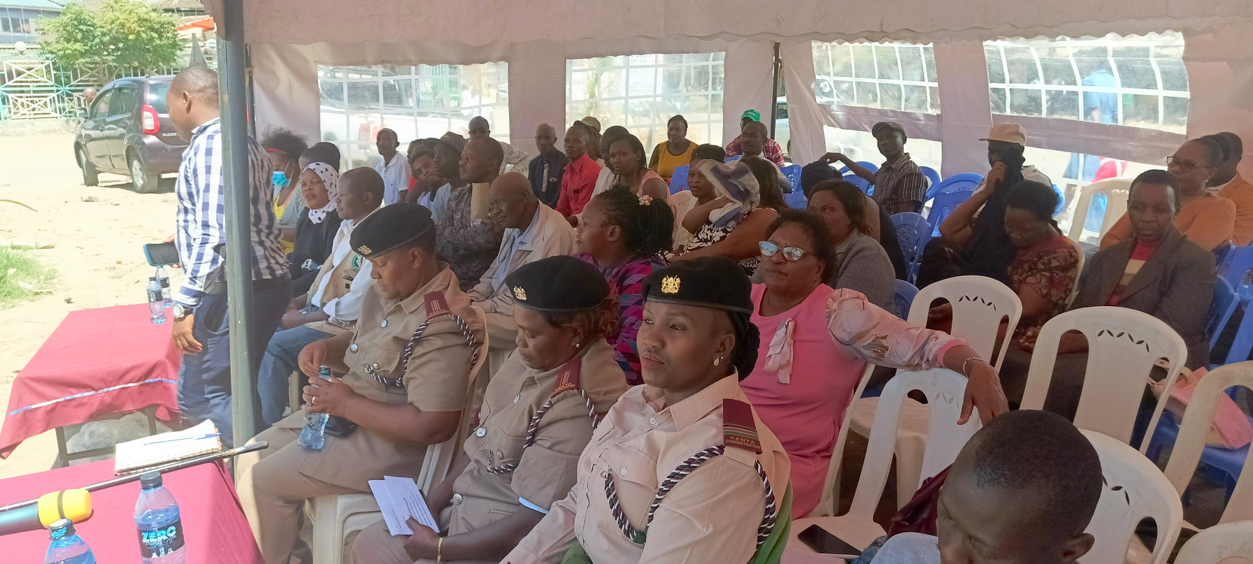
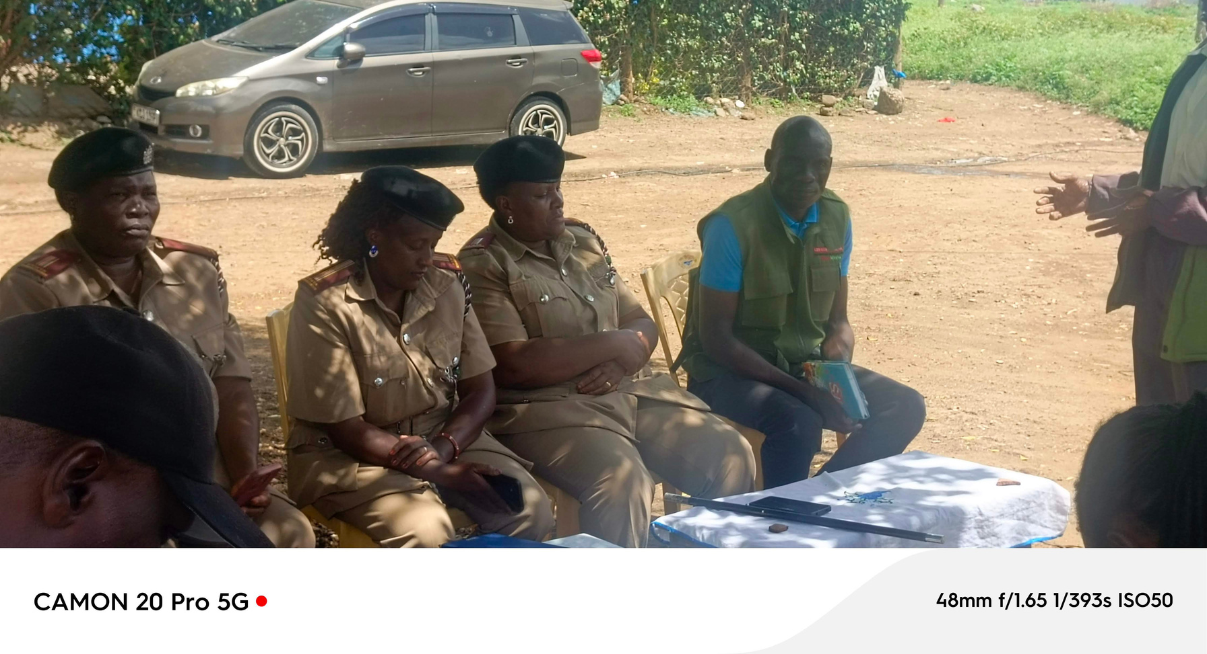
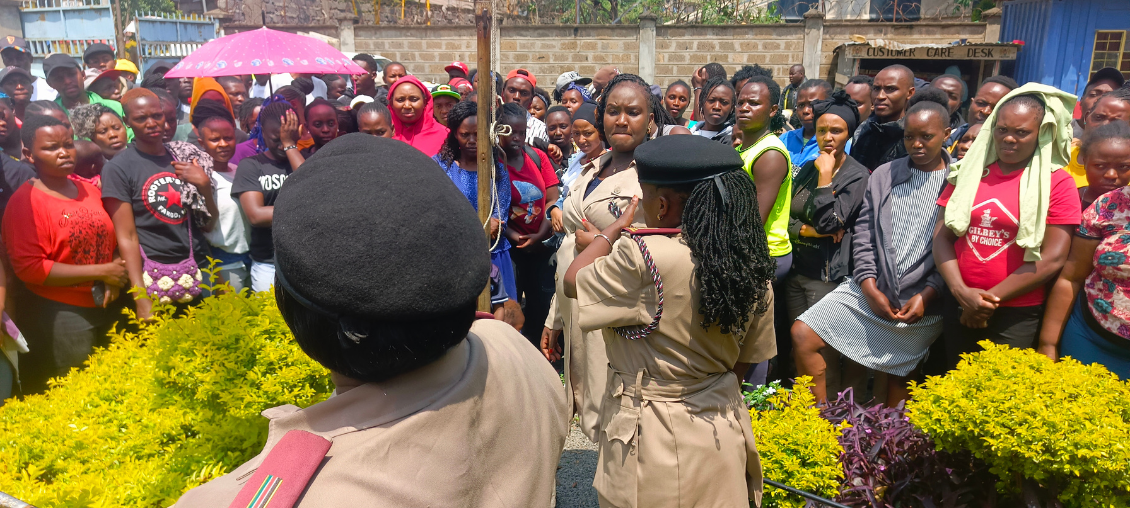
Lifeguard Kenya Engaging the local administration on creating awareness on Online child Sexual Exploitation and Abuse (OCSEA)

Slide 6
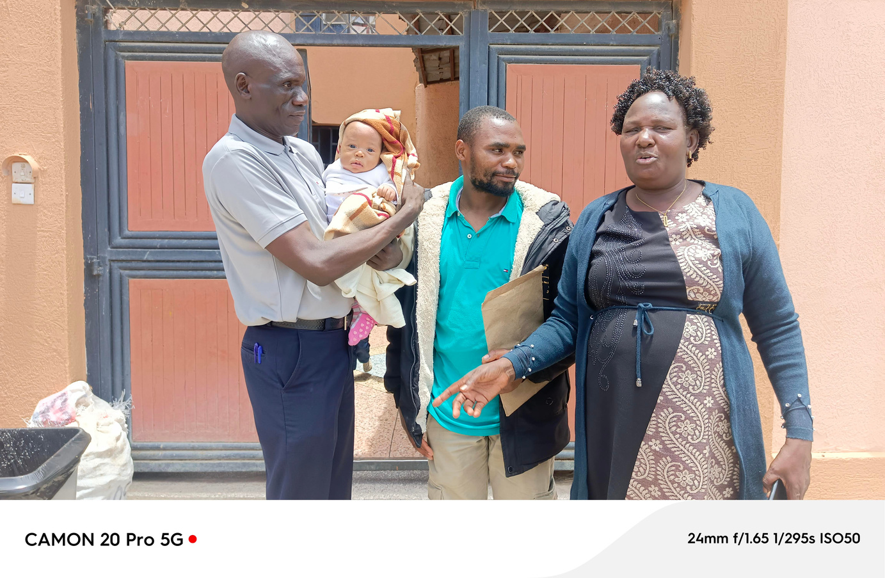
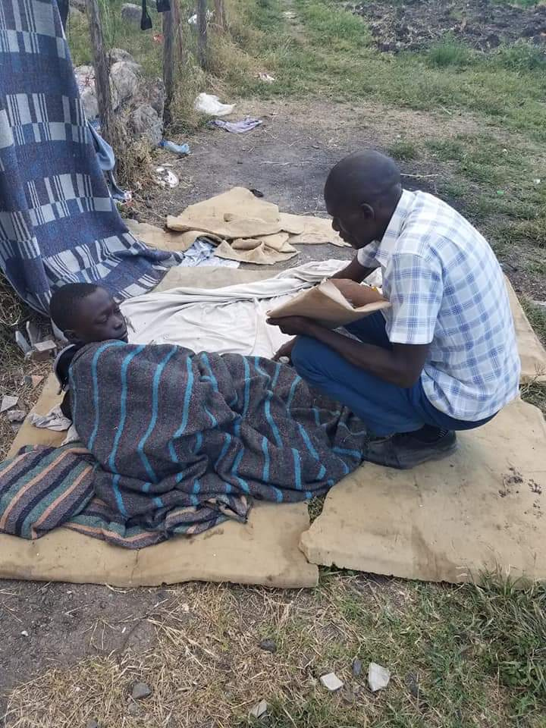
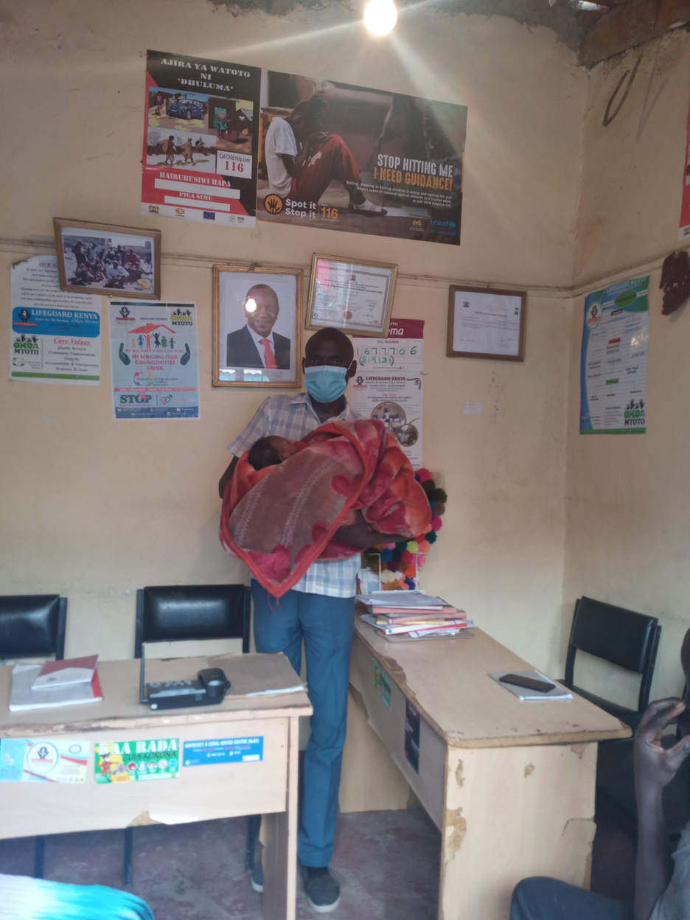
OKOA MTOTO
Lifeguard Rescuing the neglet and abandoned kid and returning the kid to the father
Saving the vulnerable and street children and taking them back to school

Slide 7
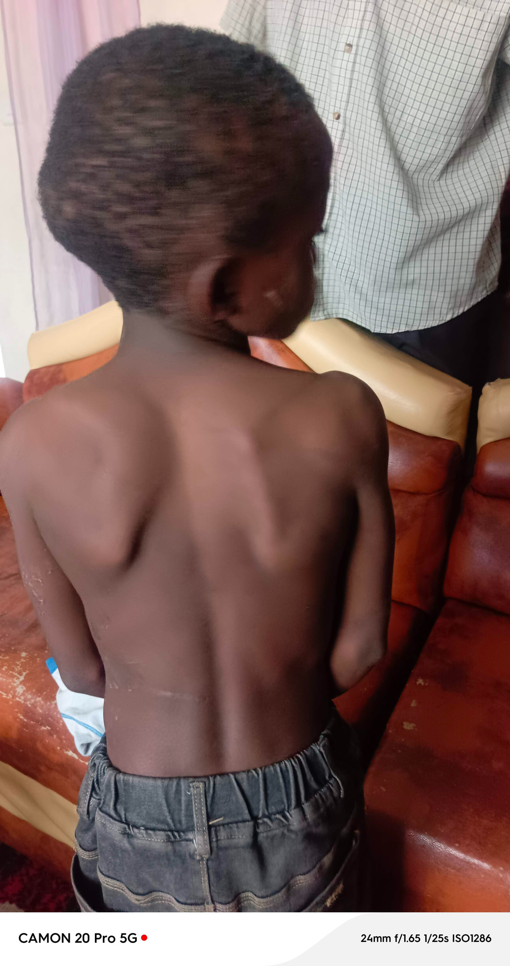
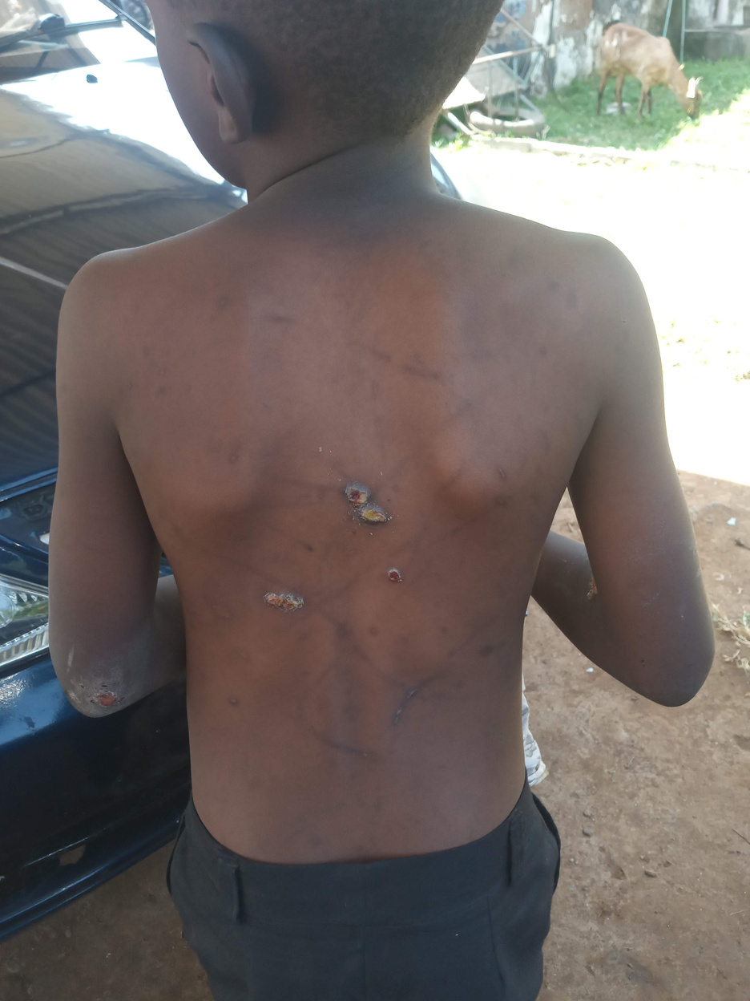
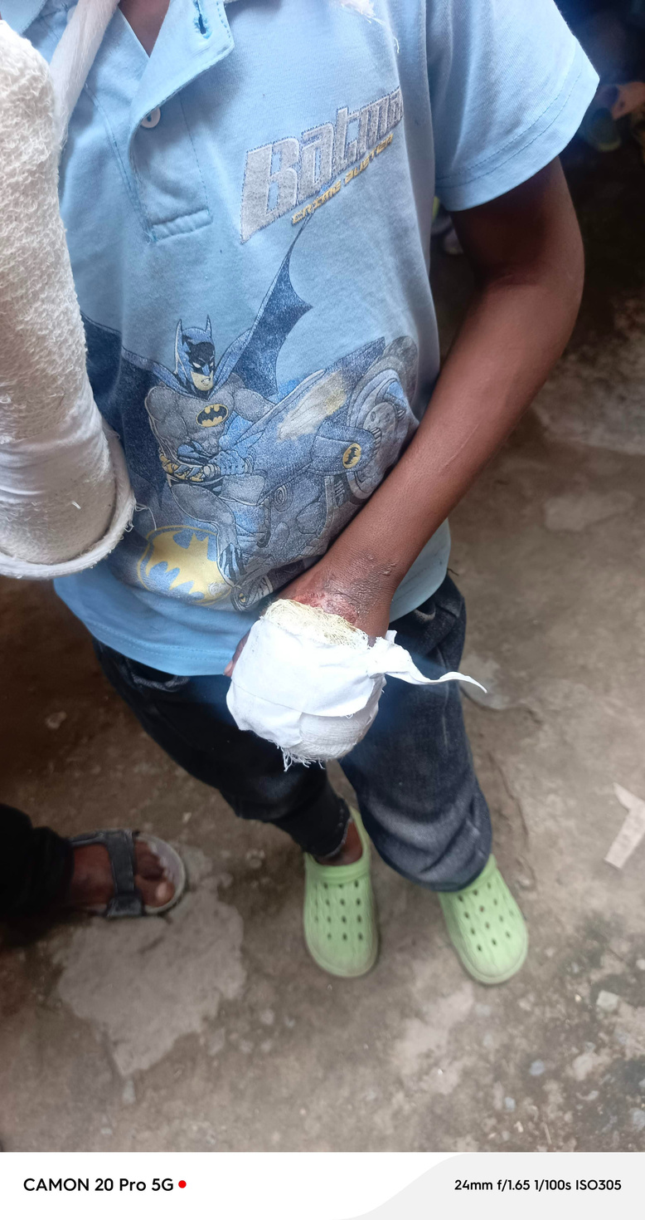
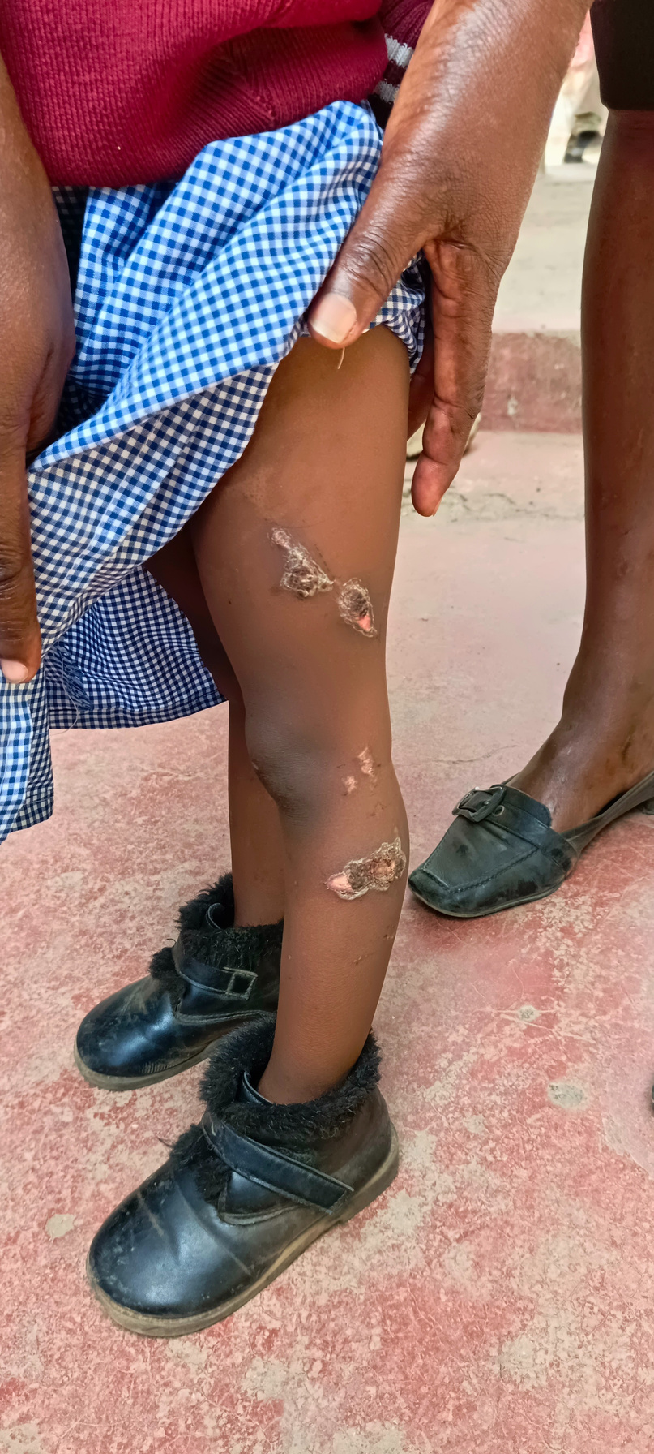
Rescued children from there parent as step mother used to abused and torture, physical asault, neglet, and neglegence.

Slide 8
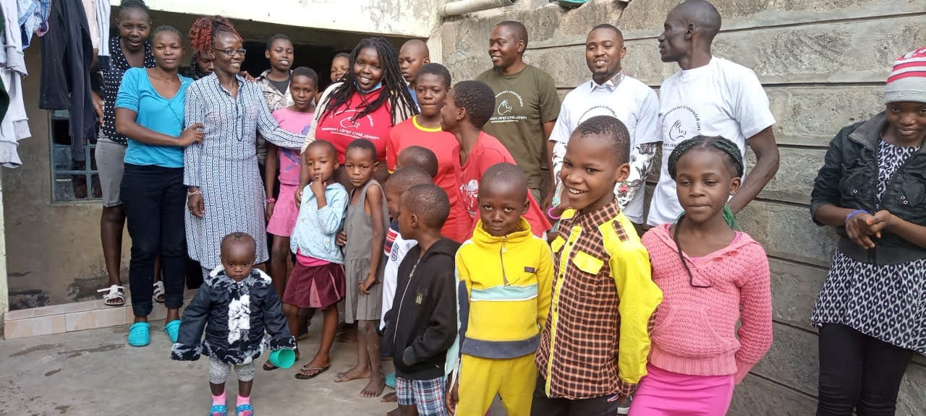
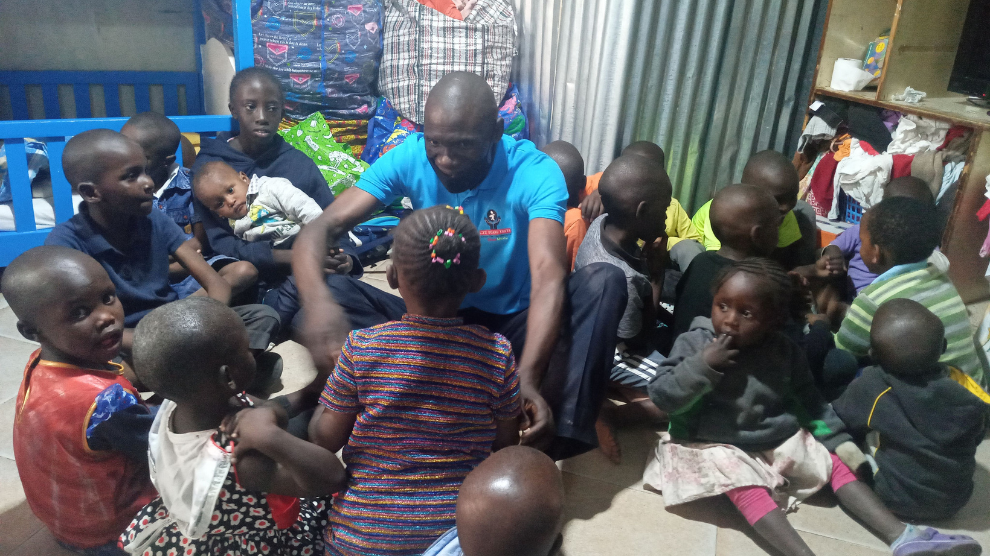
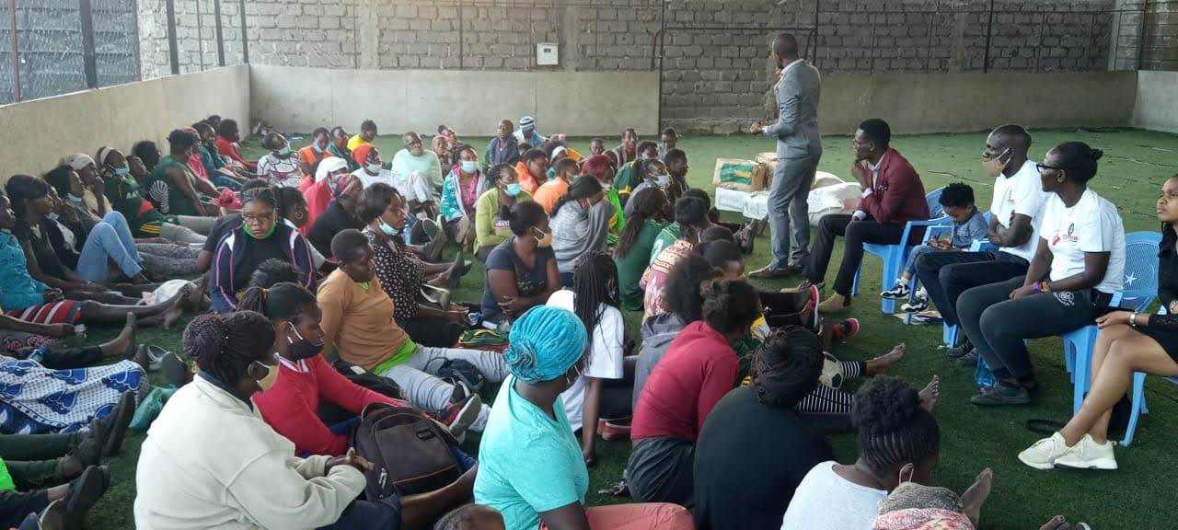
Rescued children at children homes.
Survivors of Gender Based Violence directly and indirectly.

Slide 9
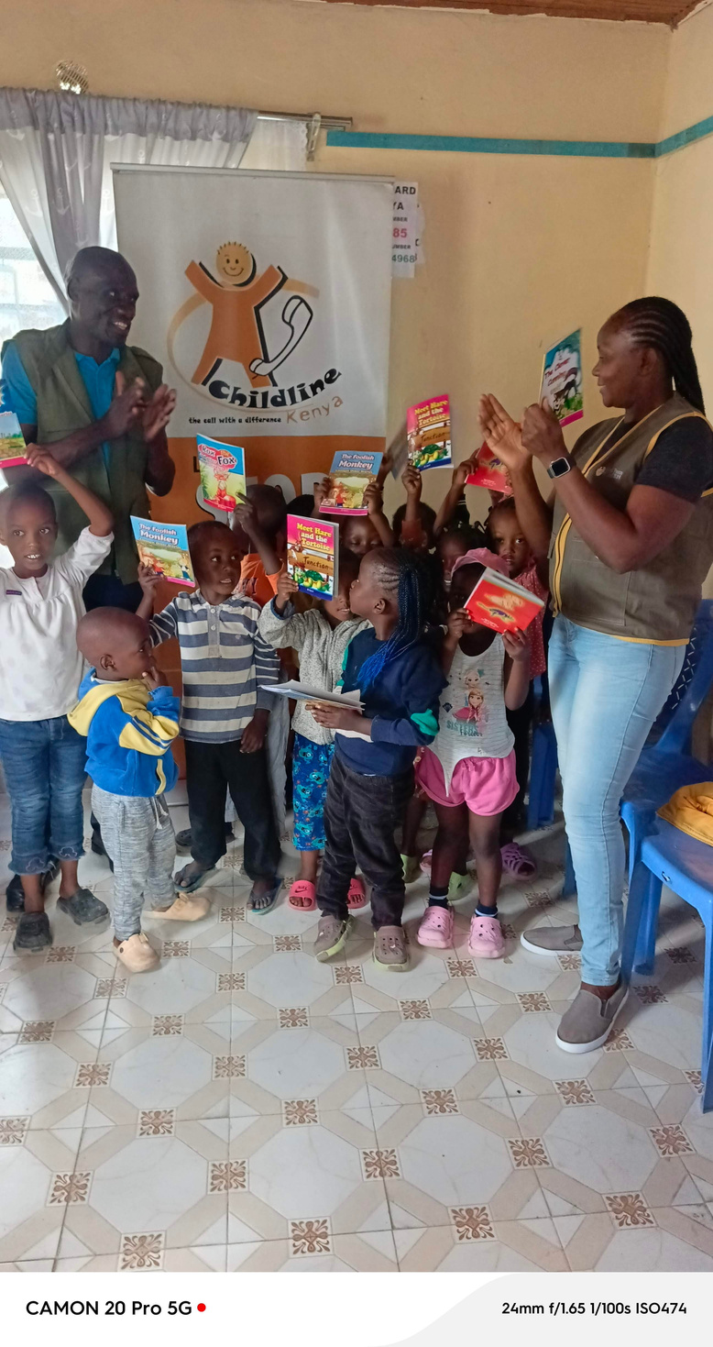
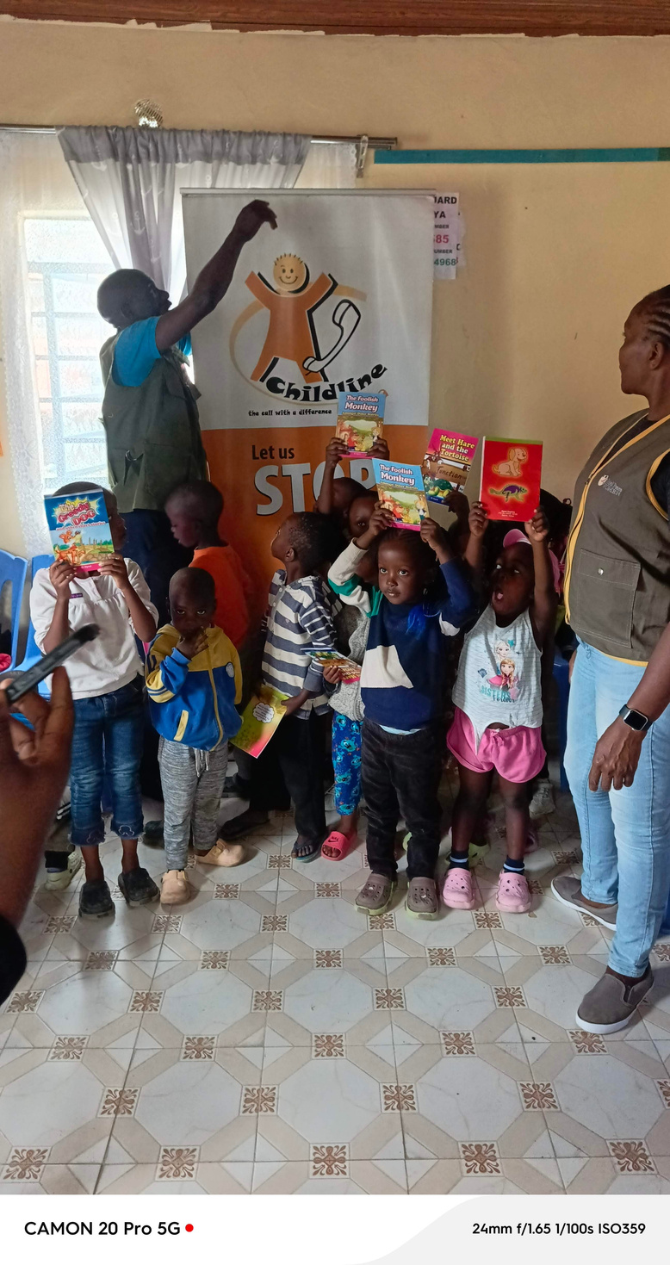
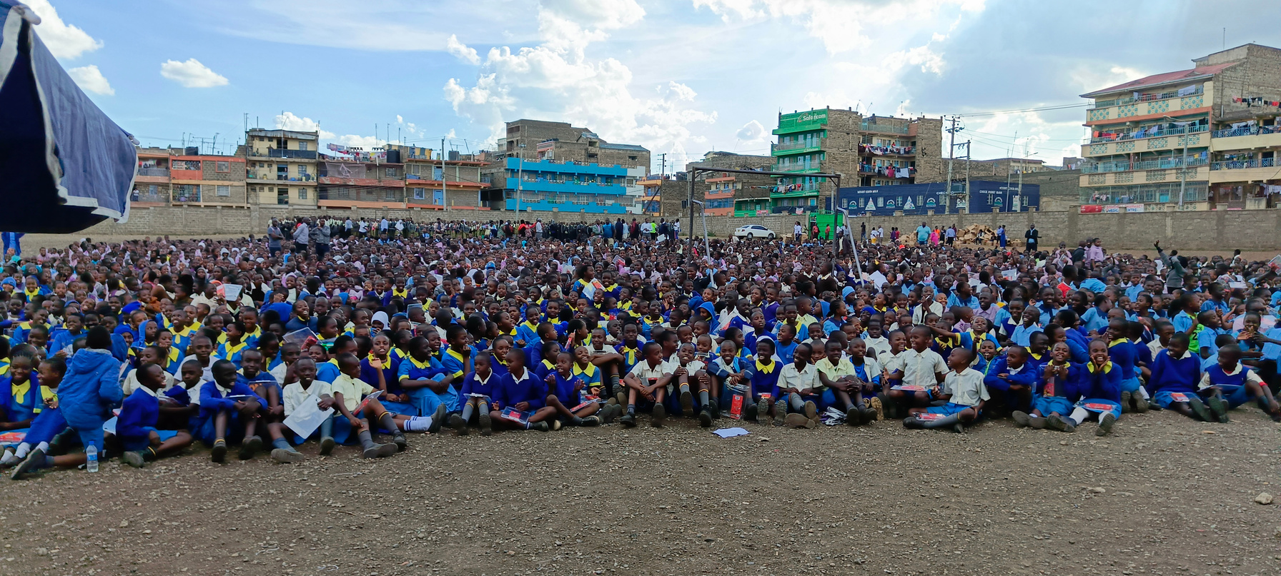
CHILDREN
ENGAGEMENT
The children act 2022 provides a right for basic education for every child
Lifeguard Kenya creating awareness on child protection on OCSEA

Slide 10
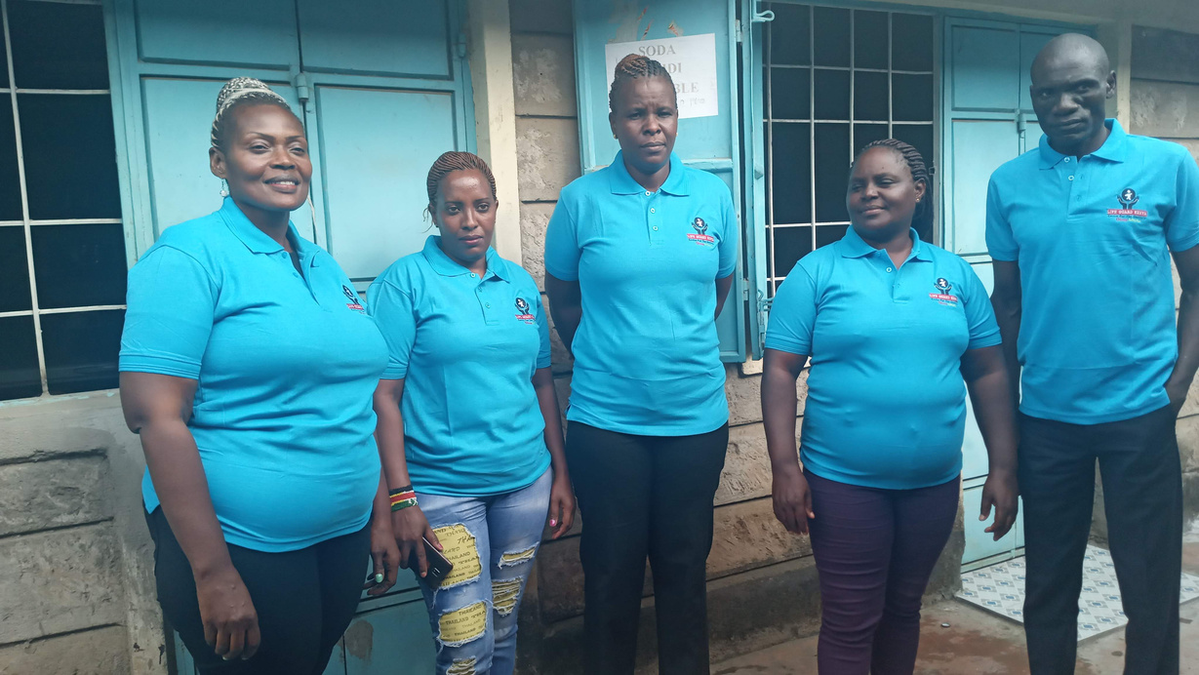
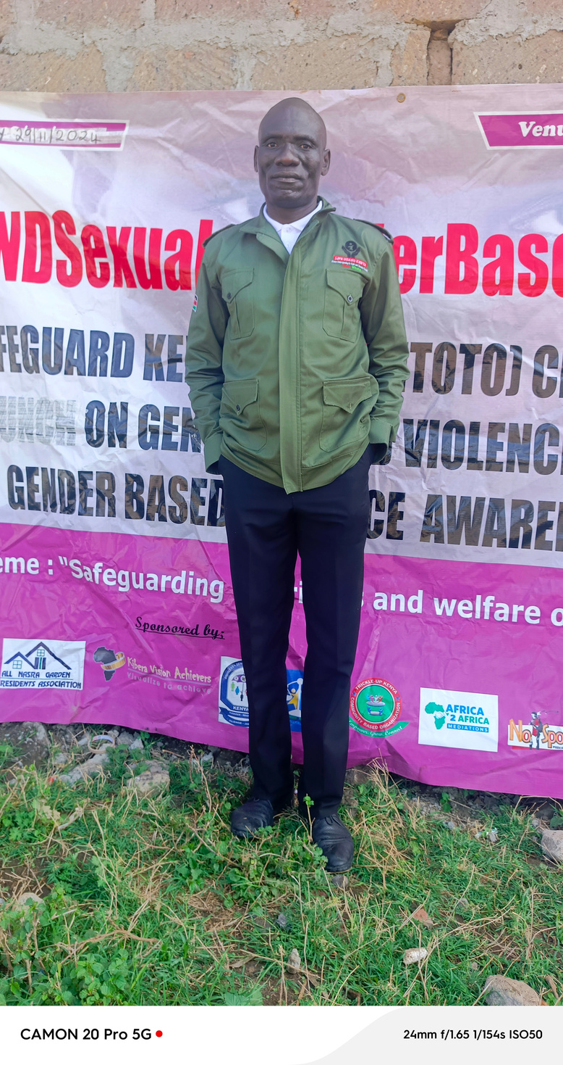

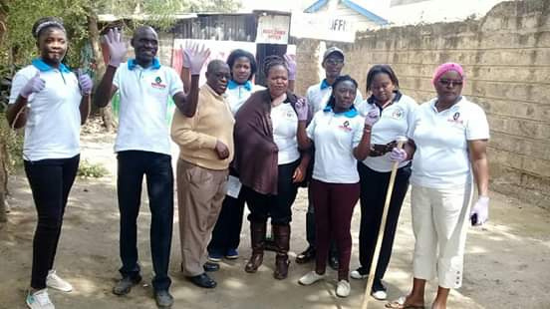
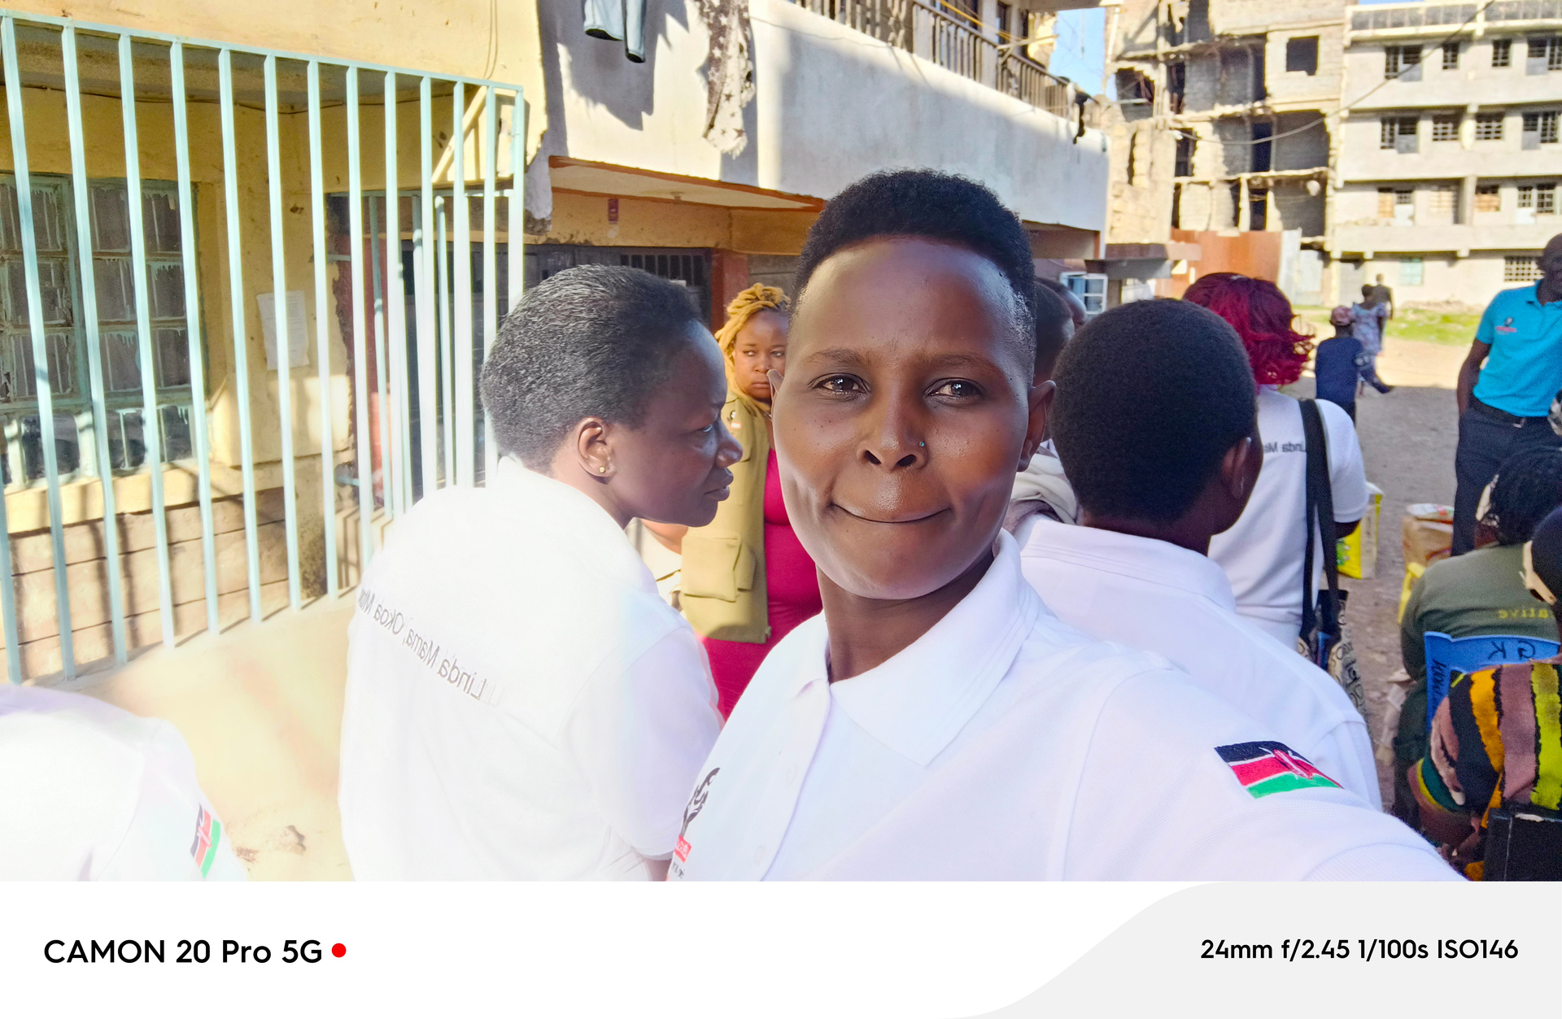
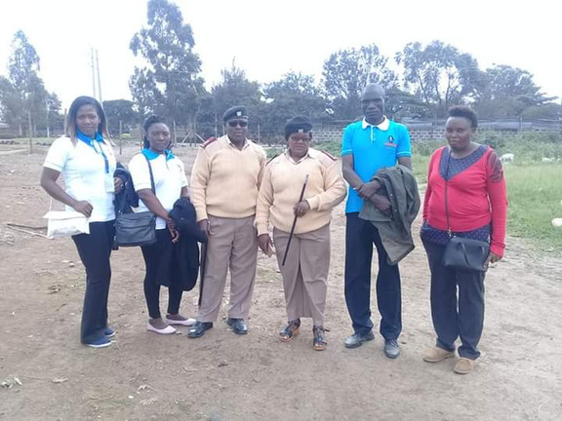
Awareness 16 days of action on Gender Based Violence

Slide 11
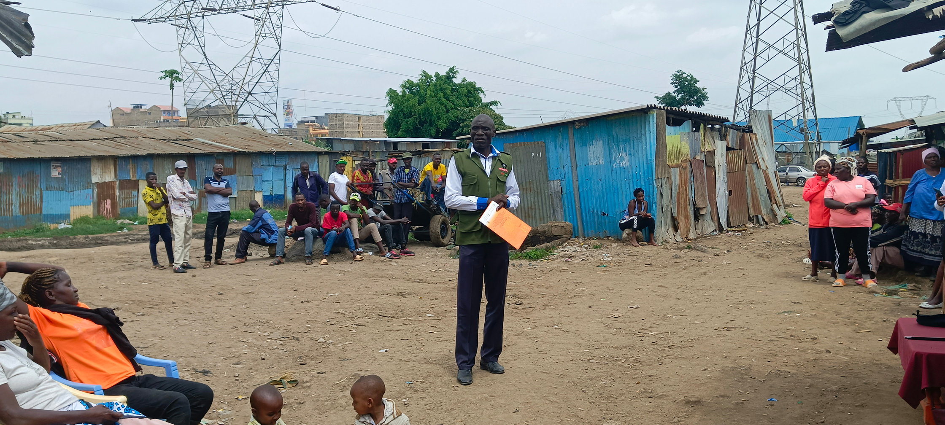
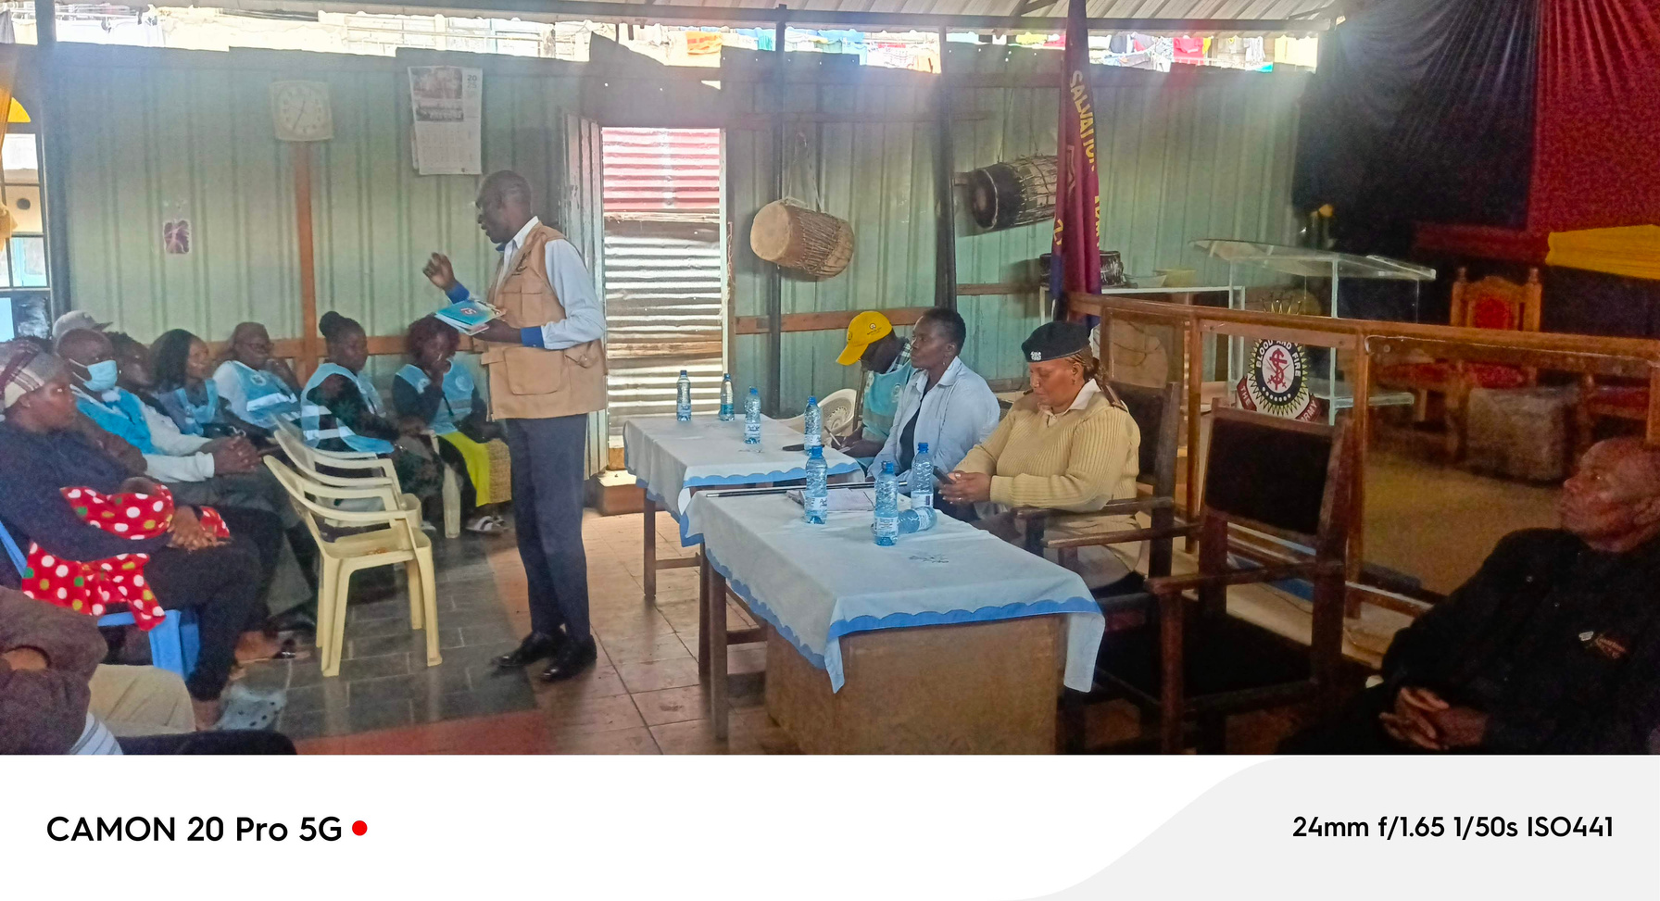
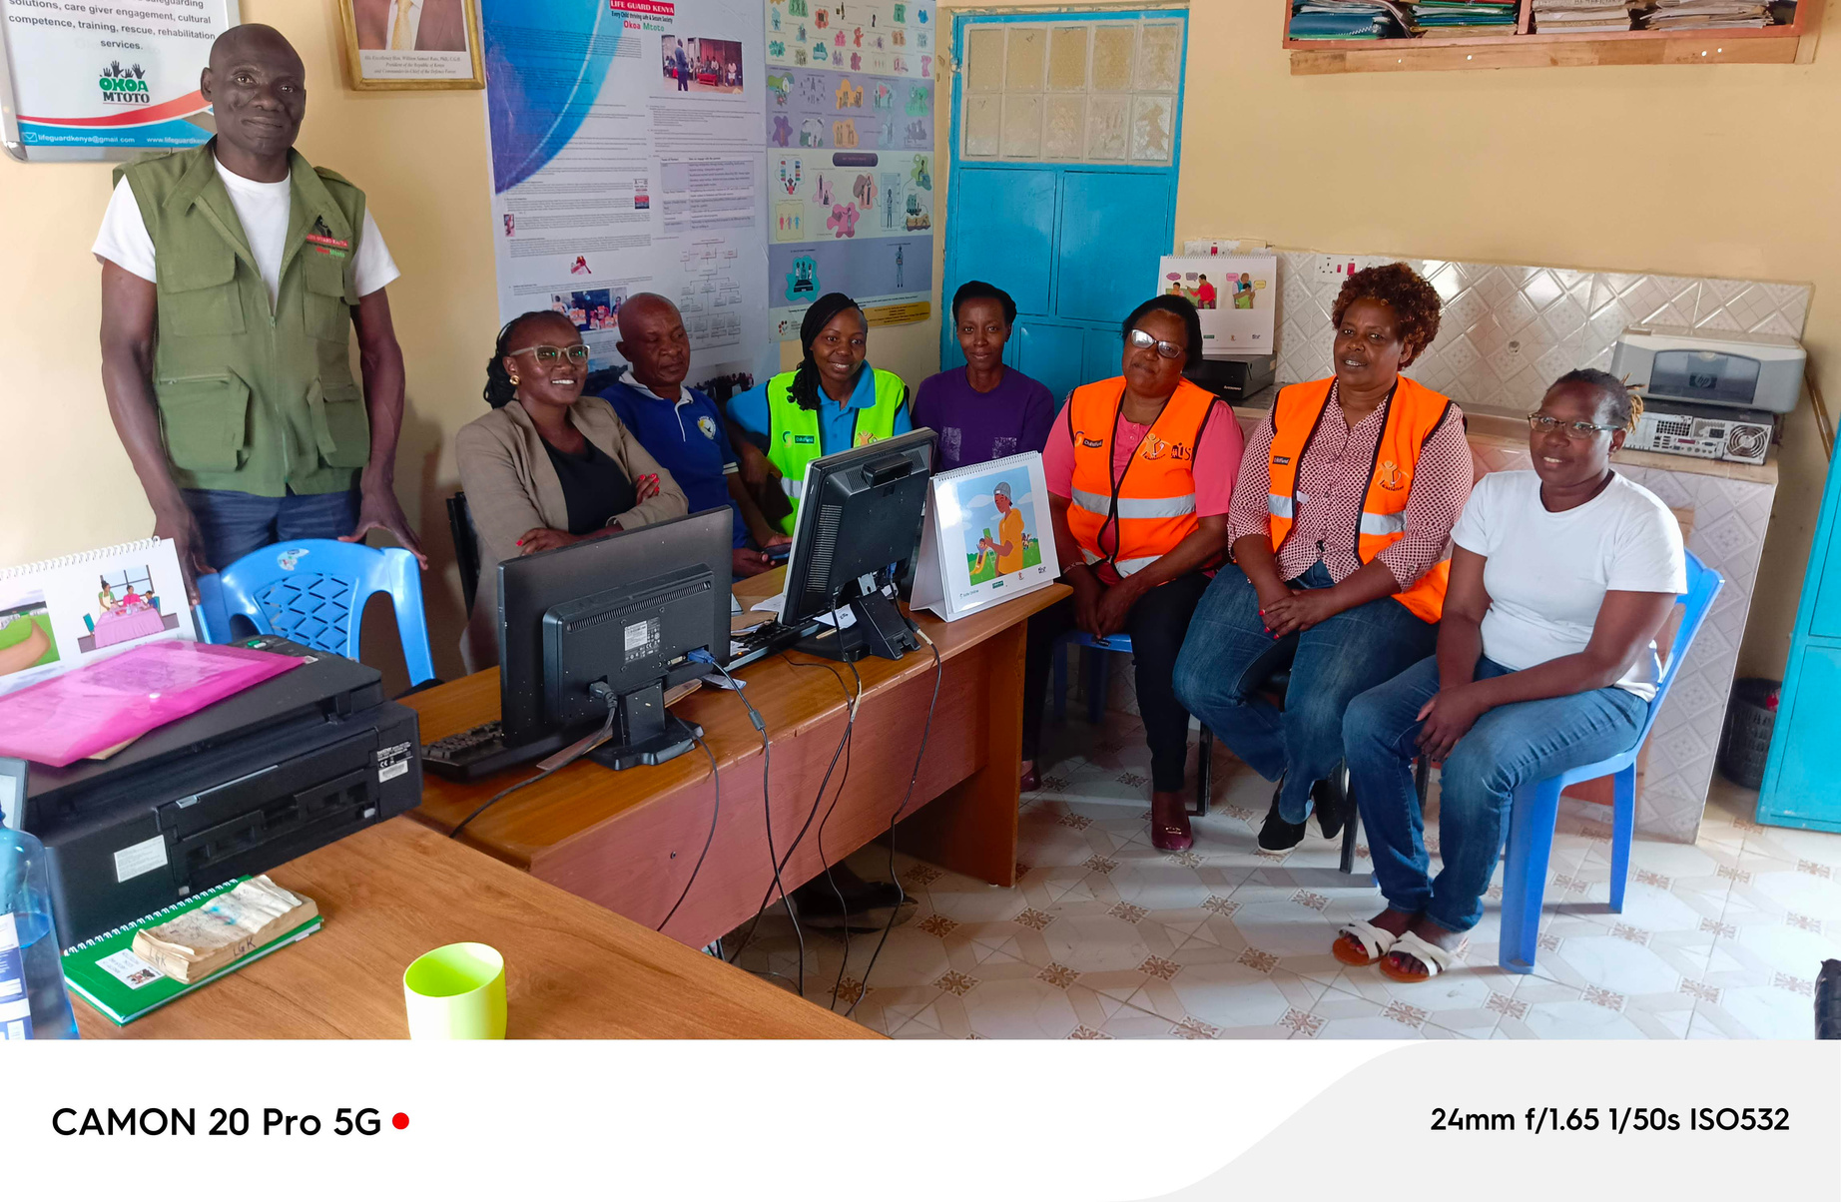
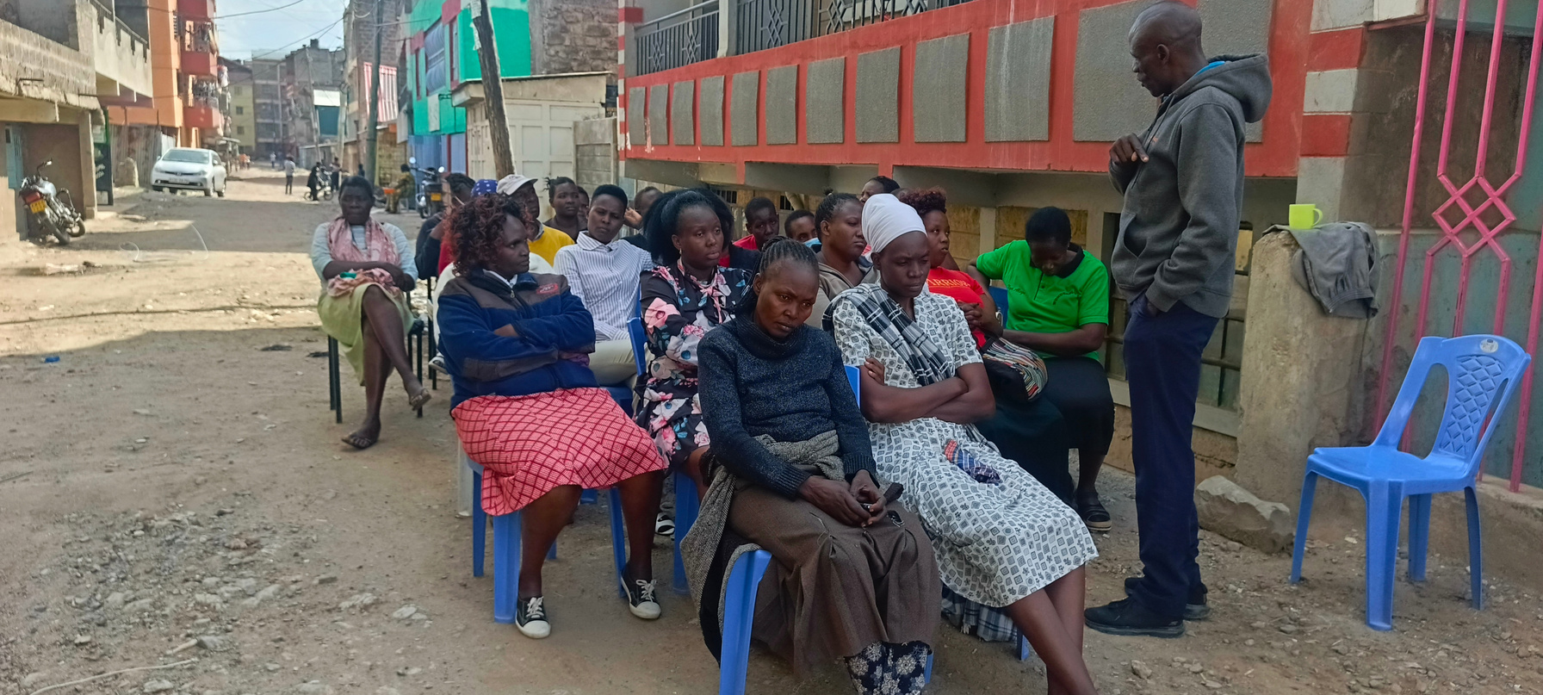
Linda Mama awareness. Lifeguard kenya with local administration creating awareness on linda mama

Slide 12
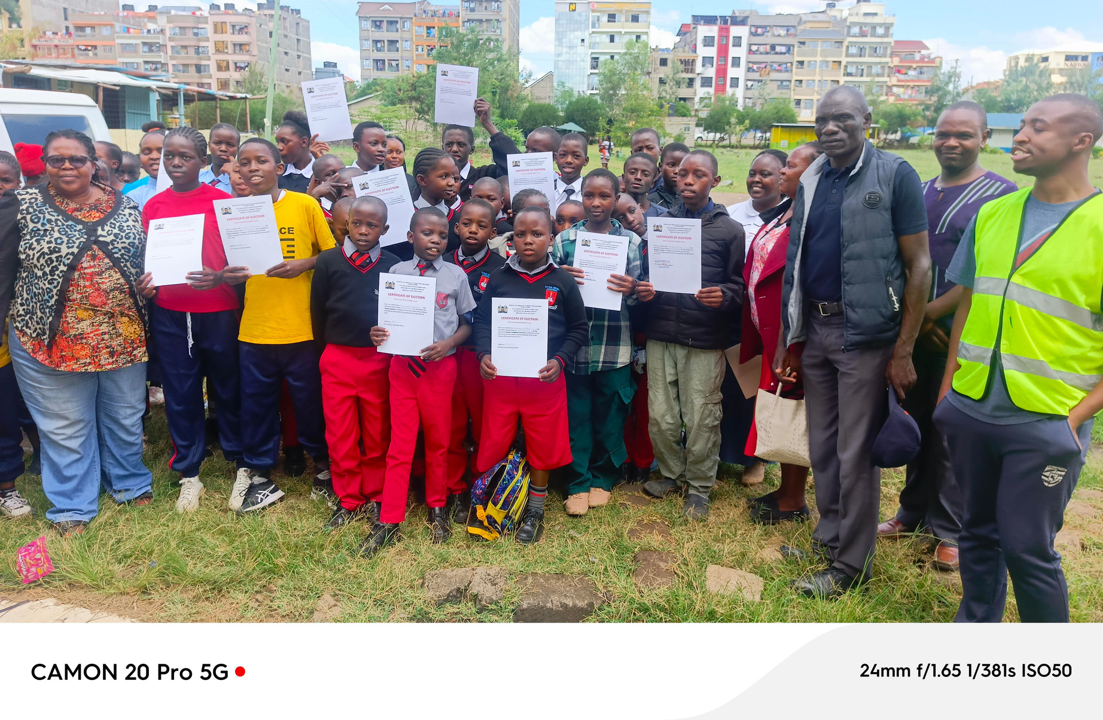
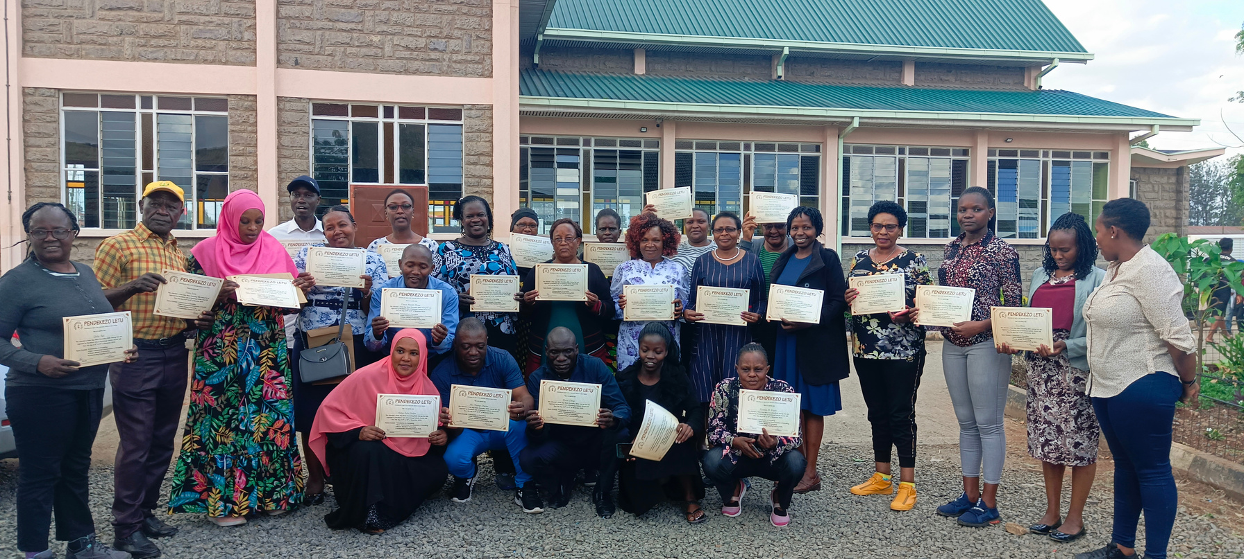
LIFEGUARD
PERFORMANCE
Training of Lifeguard champions and child protection volunters

Slide 13

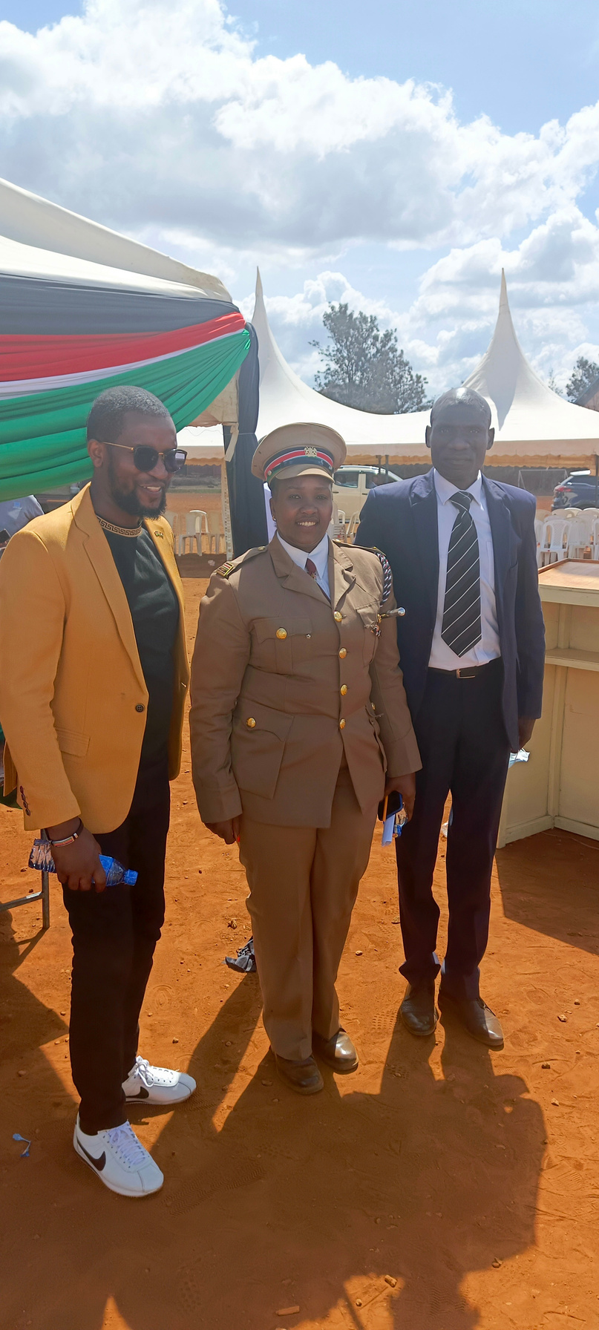
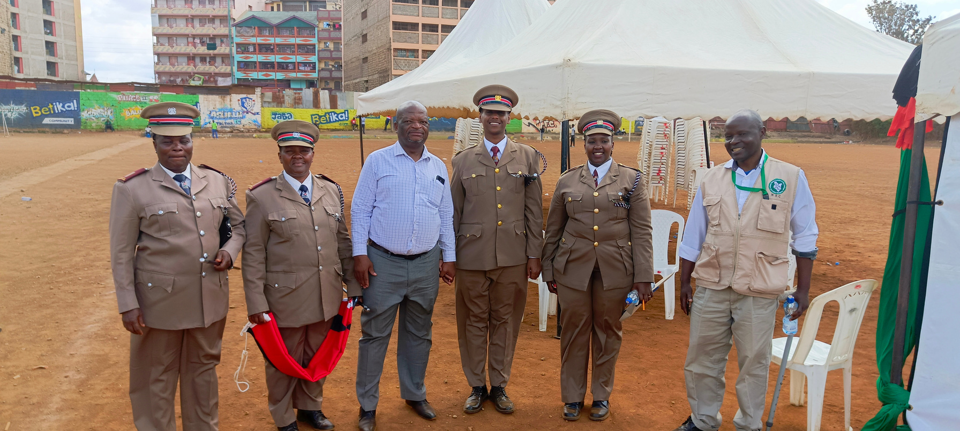
LIFEGUARD COLLABORATORS
Lifeguard collaborate together with the local administration to ensure that all rights are well served

Slide 14

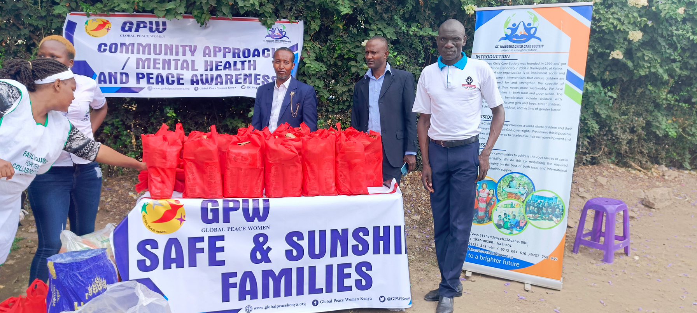
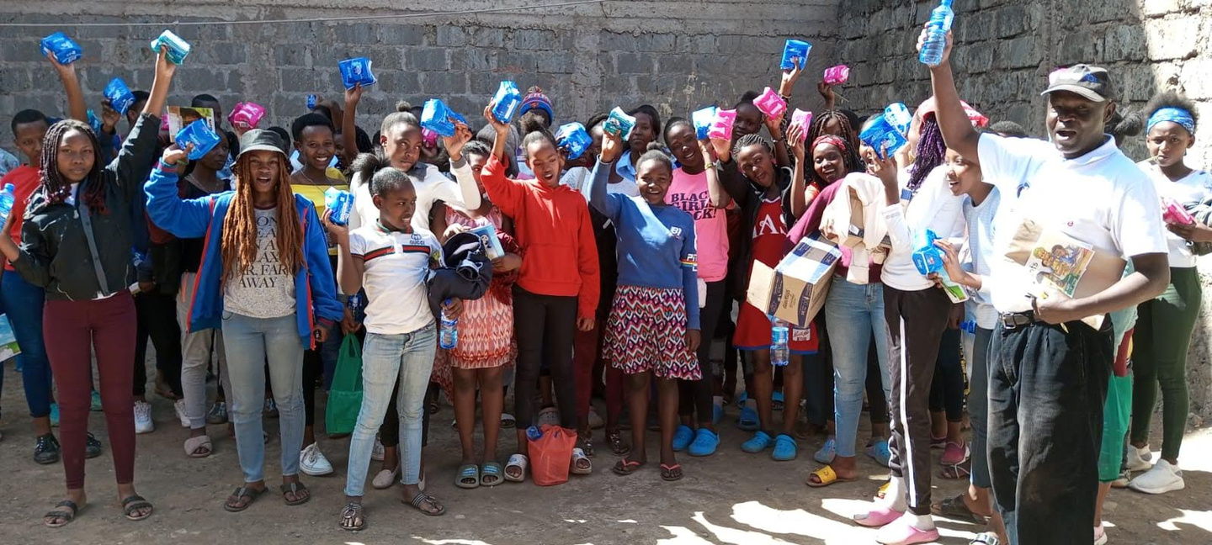
LIFEGUARD SUPPORTING THE COMMUNITY
Community approach , mental health and peace awareness
Lifeguard kenya issuing sanitary towels to girls

Slide 15

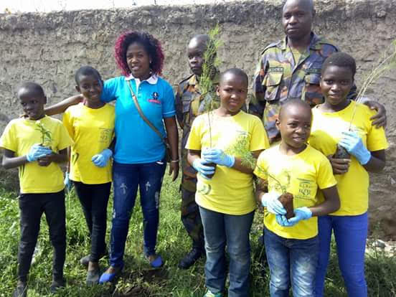
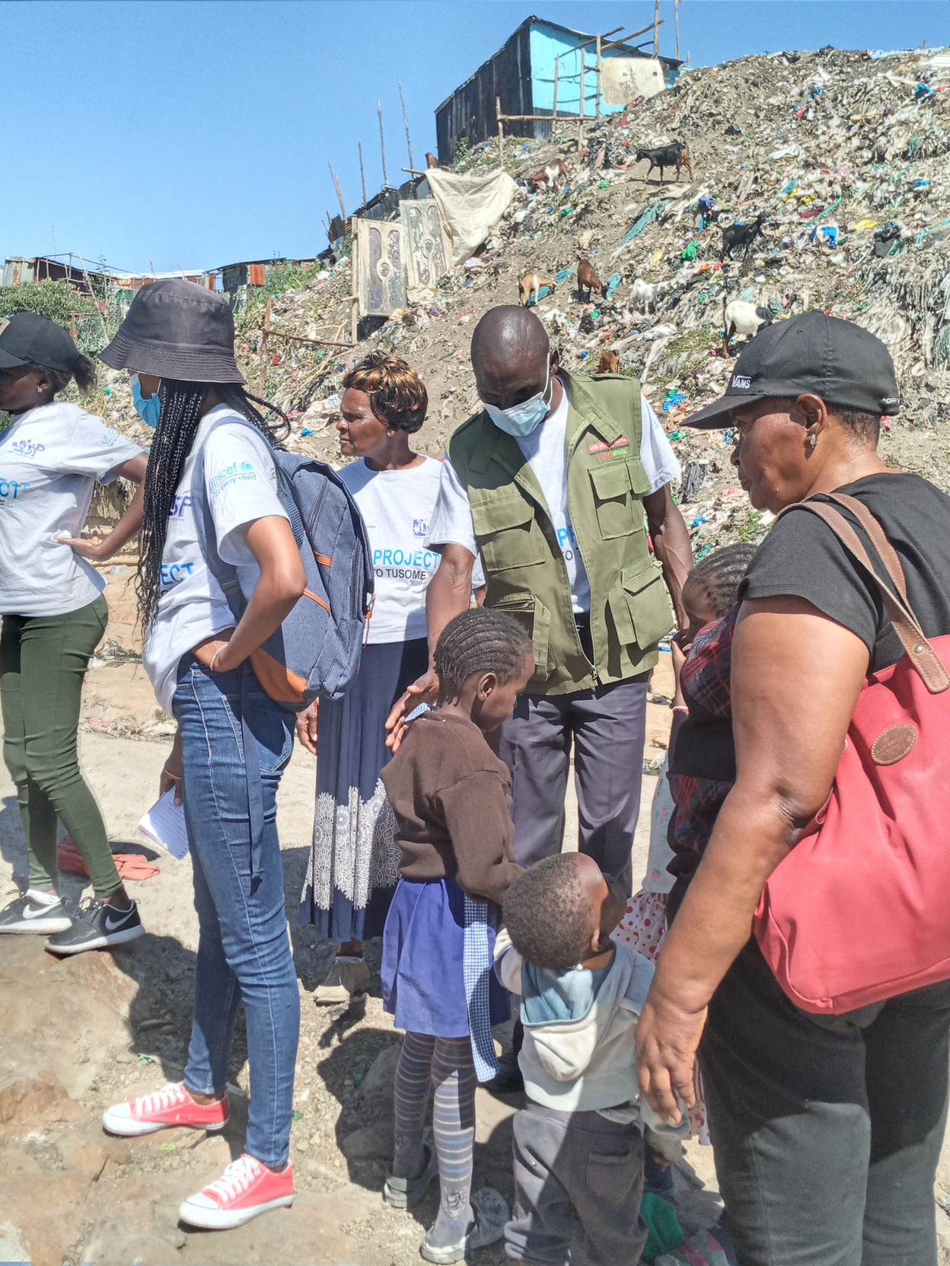
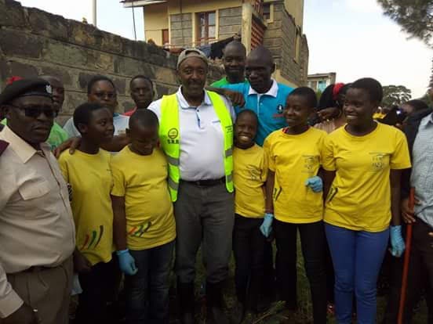
Lifeguard in frontline to implement the kenya affforestation vision 2030 of planting trees
Lifeguard kenya rescuing children who are undergoing the worst form of child labour at the soweto dump site back to school.

Slide 16

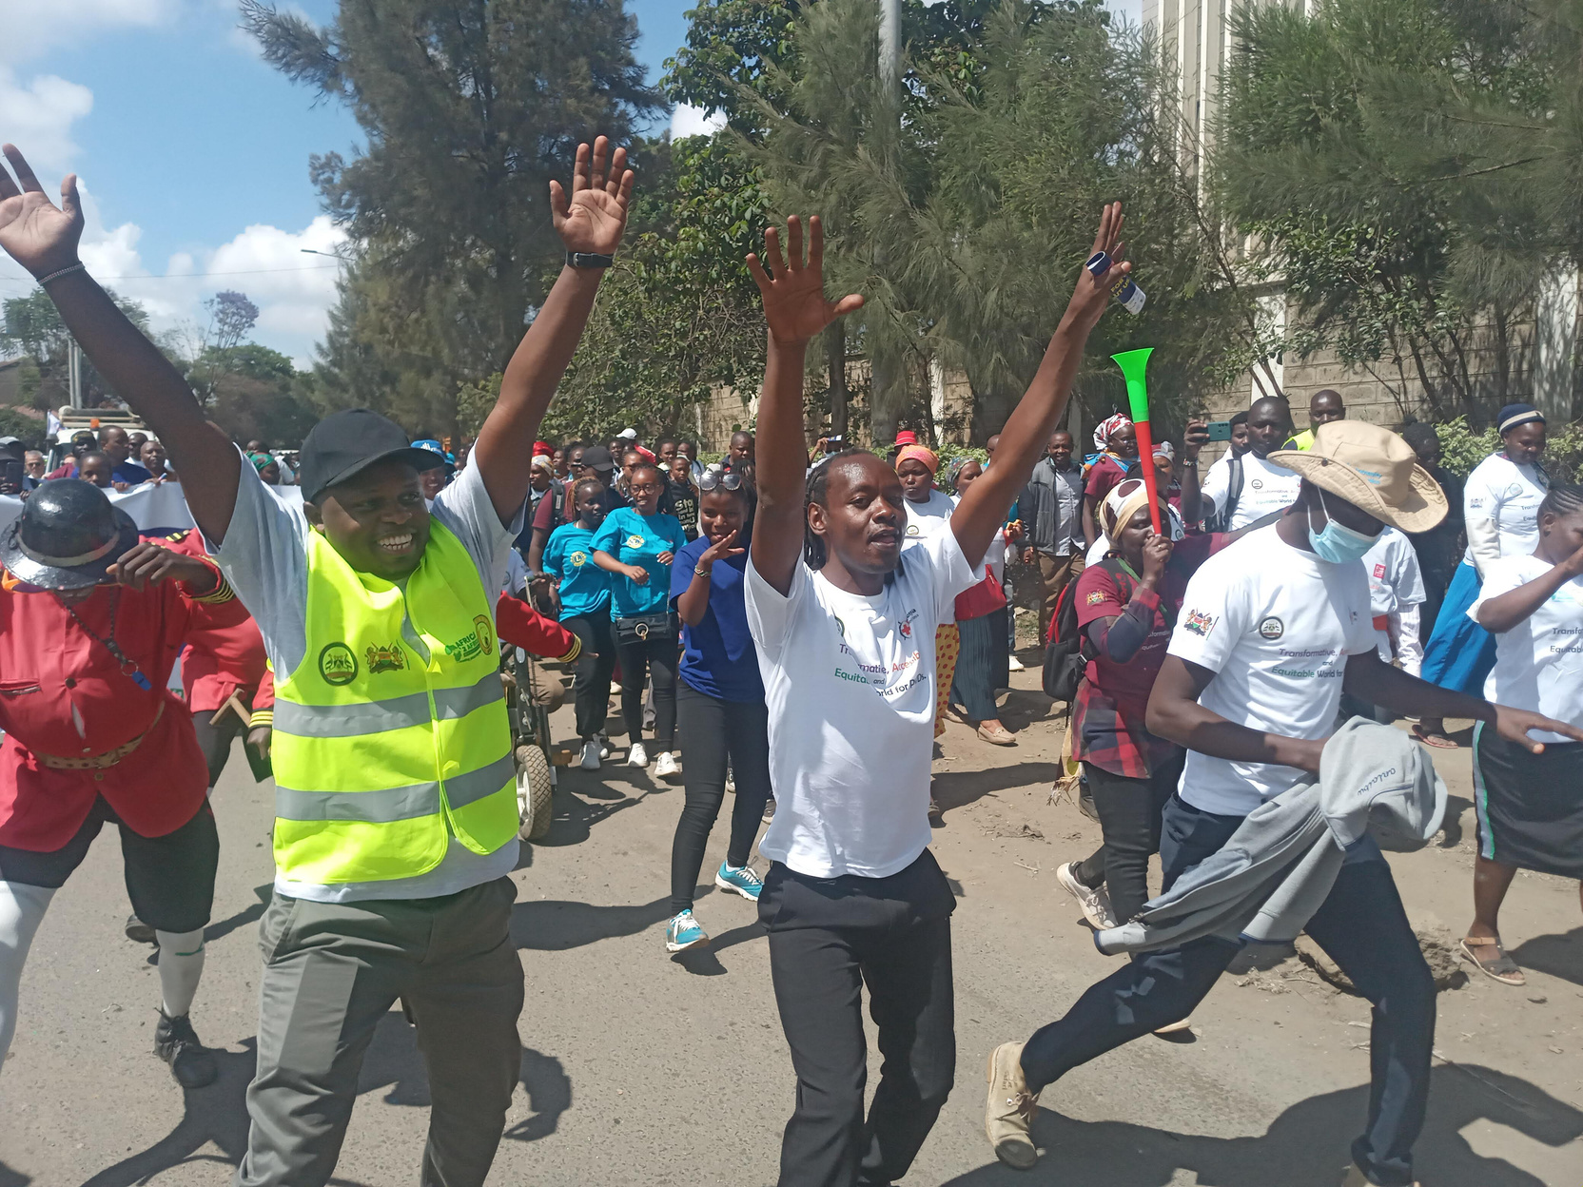
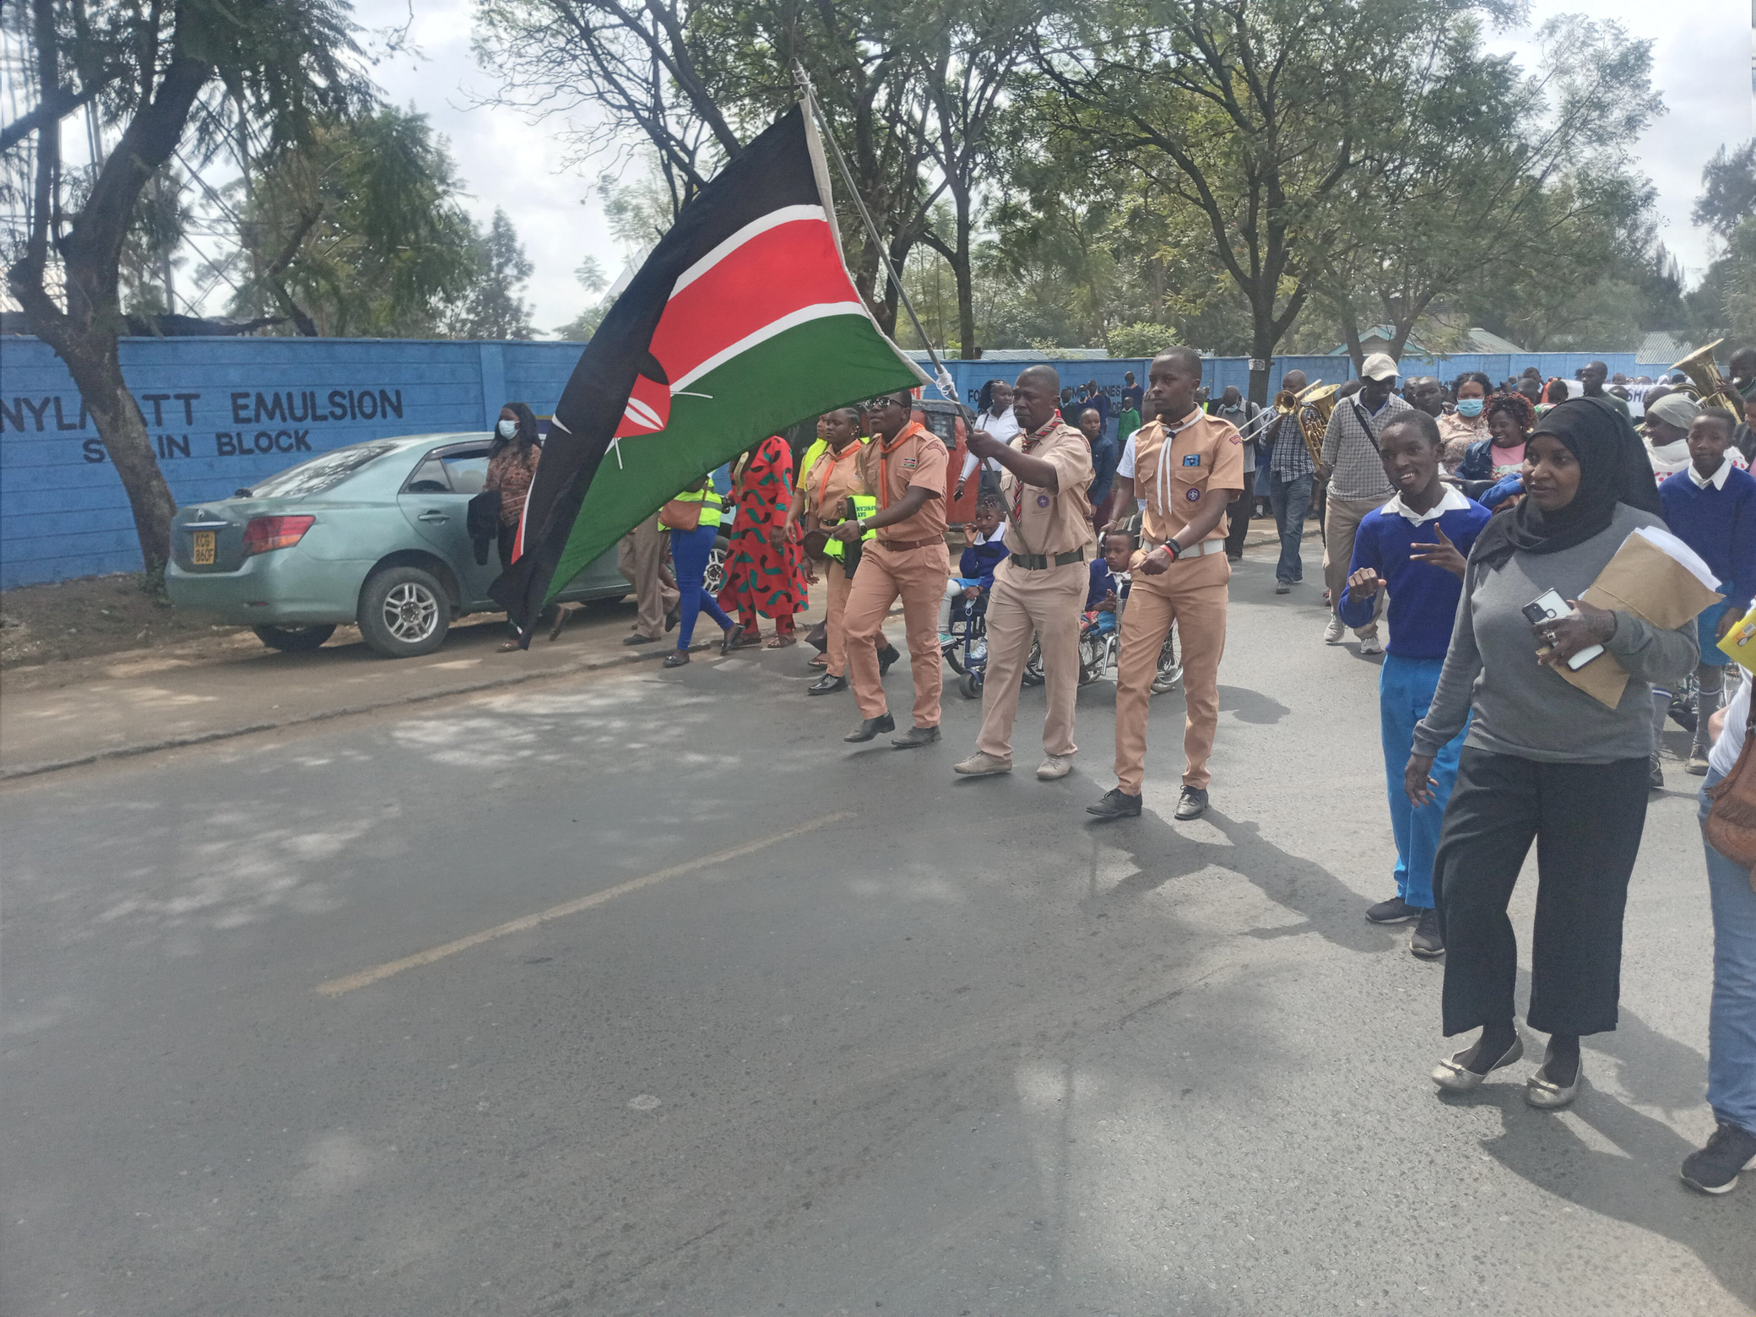
LIFEGUARD ENREACHING ACTIVITIES
Lifeguard kenya participate in enriching activities. We actively engage in programs that promote safety, wellness, and community involvement

Slide 17
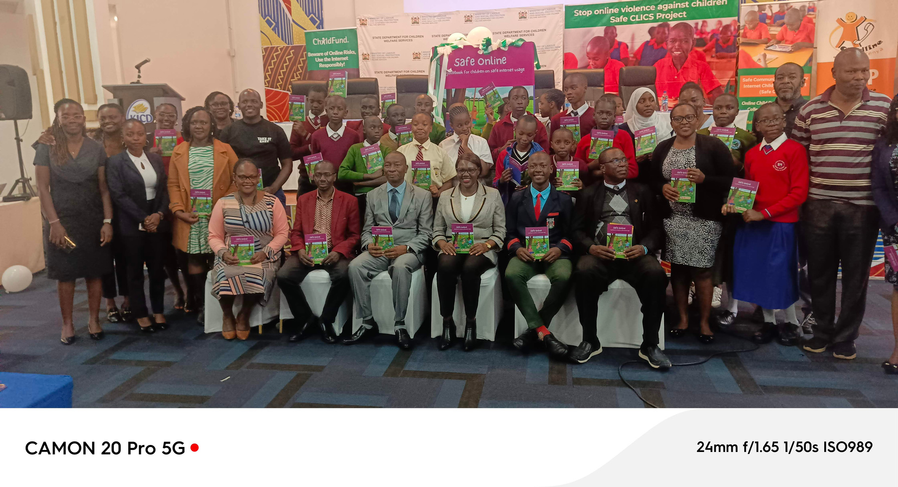
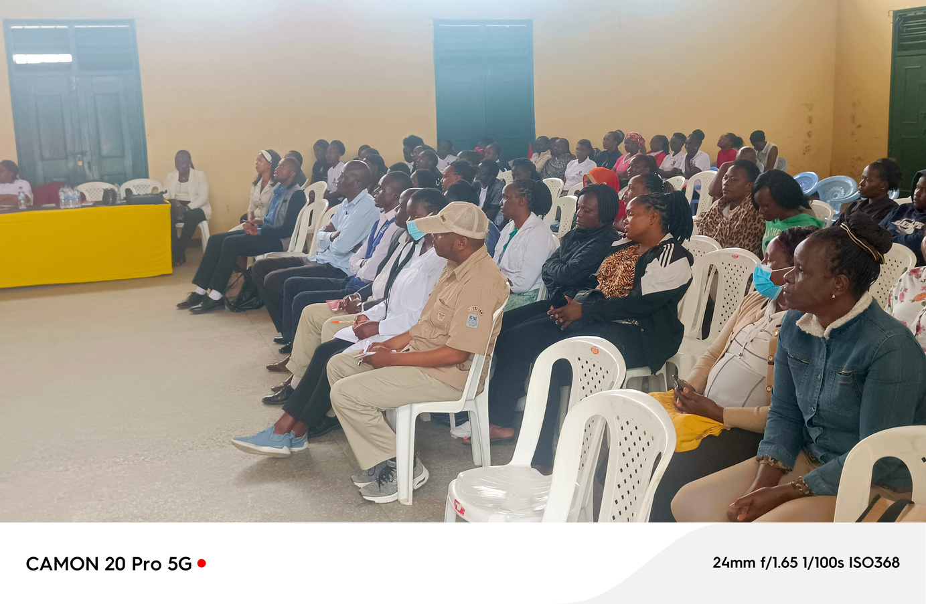

A launch on safe online- safe internet usage and online safety for children.
Engaging the judiciary on community awareness on Children Service

Slide 18



THANK YOU
CALL
116
0722466501 / 0795989113
lifeguardkenya@gmail.com

